Slide 1
CS512L
OBJECT DETECTION IN UNDERWATER SCENARIOS
Team 11
A Jyothiraditya - CS22B002
M Akash - CS22B037
M Dhanush - CS22B053
Ch Sai Madhav - CS22B060

Slide 2
AGENDA OVERVIEW
01
04
PROBLEM STATEMENT
PROPOSED METHOD
02
05
LITERATURE SURVEY
RESULTS AND METRICS
03
06
CHALLENGES
CONCLUSION

Slide 3
PROBLEM STATEMENT
Our study focuses on detecting and classifying objects in underwater environments using computer vision techniques.
MOTIVATION
Underwater exploration (e.g., marine life monitoring, archaeology, infrastructure inspection) needs accurate visual detection.
Challenging conditions like low visibility, light scattering, turbidity, and occlusion affect detection quality.
Boosting automation for AUVs (Autonomous Underwater Vehicles) in navigation and object interaction.

Slide 4
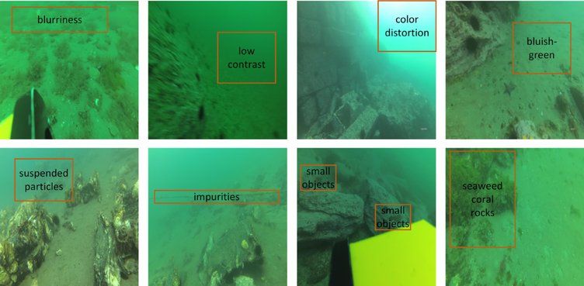
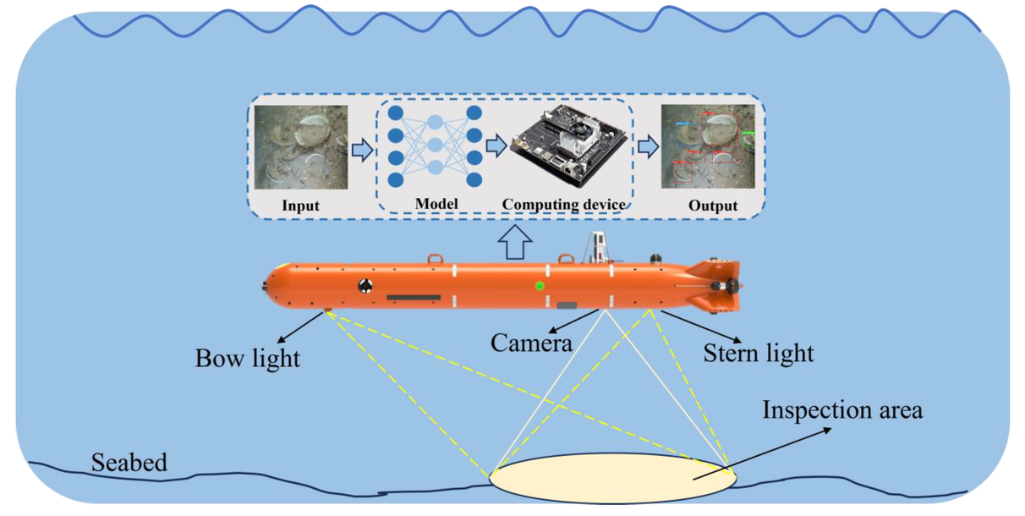
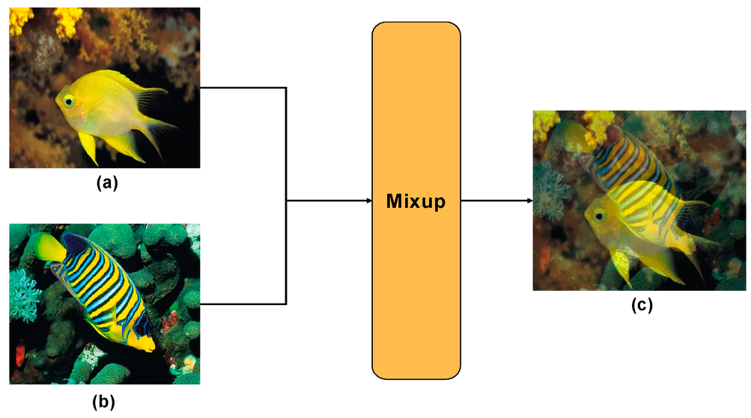
CHALLENGES
Our study focuses on detecting and classifying objects in underwater environments using computer vision techniques.
01
02
03
LOW ACCURACY
REAL TIME CONSTRAINTS
HIGH FALSE POSITIVE
Low accuracy due to light scattering, attenuation, and small/blurred targets.
High computational load in underwater environments.
High false positive rate in deep models due to color similarity in underwater scenes.

Slide 5
LITERATURE REVIEW
Traditional vs. Deep Learning Methods:
Traditional Methods: Handcrafted features + sliding windows → slow, less accurate.
Deep Learning Approaches:
Two-stage (e.g., Faster R-CNN): High accuracy, low speed.
Single-stage (e.g., YOLO, SSD): Fast, suitable for real-time underwater tasks.

Slide 6
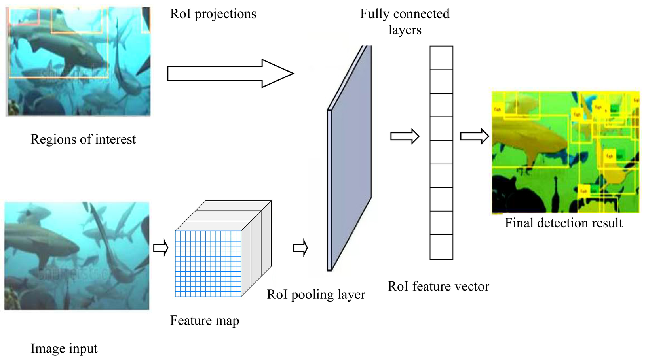
LITERATURE REVIEW
Faster R-CNN for small targets:
Used Hybrid Dilated CNN in Faster R-CNN for small targets.
It replaces the VGG16 network in Faster R-CNN

Slide 7
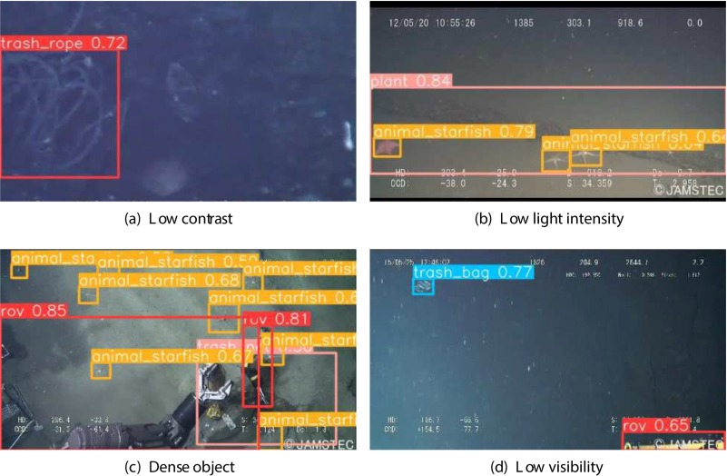
LITERATURE REVIEW
2. CEH-YOLO with High-order Deformable Attention:
A composite enhanced YOLO-based underwater target detection model, CEH-YOLO, which incorporates High-order Deformable Attention (HDA).

Slide 8
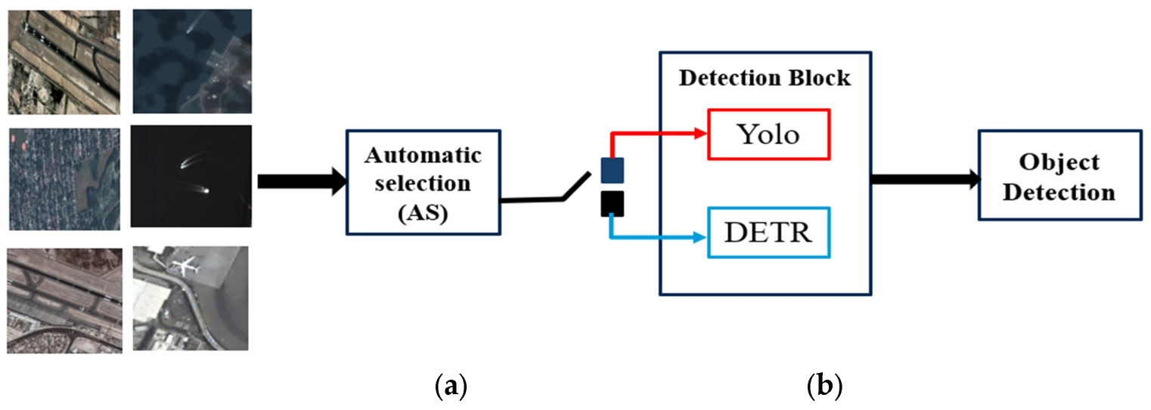
LITERATURE REVIEW
3. YOLOv7 + Contextual Transformer for detail capture:
A Deformable Convolutional Network (DCN) into the backbone network of YOLOv7 and added Contextual Transformer 3, enhancing the model’s ability to perceive image details and improving the average precision by 2.8% on the URPC dataset.

Slide 9
LITERATURE REVIEW
Identified Gaps
Poor handling of multi-scale features.
Redundant parameters in detection heads.
Difficulty detecting small/fuzzy underwater targets.
Motivation for YOLOv8-UC
Need for a model with:
Higher accuracy
Better feature extraction
Faster convergence
Lower computational cost

Slide 10
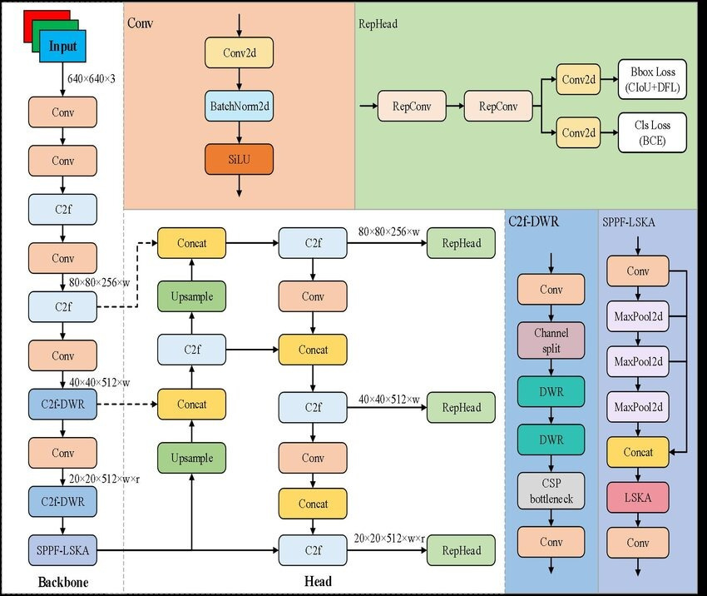
PROPOSED METHOD

Slide 11
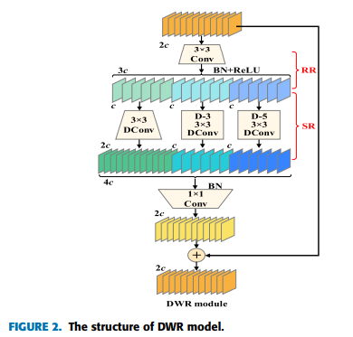
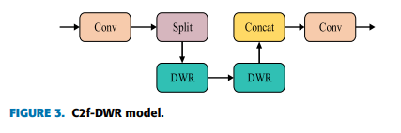
PROPOSED METHOD
C2F-DWR MODULE
Problem:
Underwater images are complicated — things look blurry, tiny, and often mix with the background.
The original C2f wasn’t good at looking at these tricky details at different scales (sizes).
Solution:
DWR helps the model see both small and large details at the same time by using different sized filters (called dilated convolutions).

Slide 12
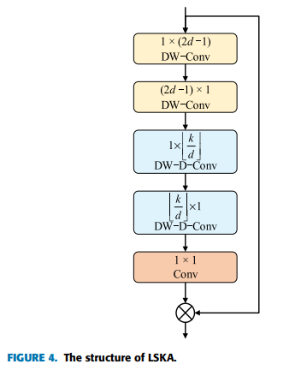
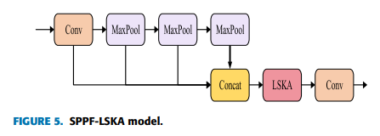
PROPOSED METHOD
SPPF-LSKA MODULE
Problem:
In YOLOv8, SPPF uses max-pooling, which only keeps the strongest signals and throws away the rest.
But in underwater images, those "weaker signals" might be important (like the edges of a seaweed or the tentacles of an octopus).
Solution:
LSKA is a smart attention module — it tells the model where to look in the image.
It looks at long-range dependencies (relationships between distant parts of the image).
It keeps more details by using smarter filtering (instead of just picking the strongest signal).

Slide 13
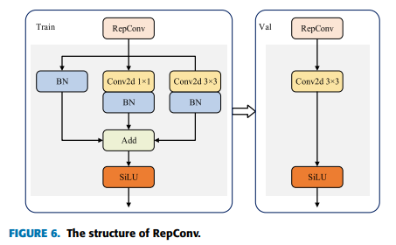
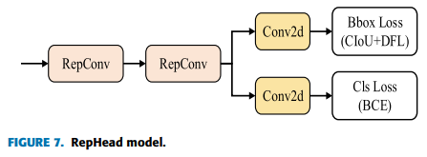
PROPOSED METHOD
REPHEAD WITH REPCONV
Problem:
The original head had two separate branches — one for finding objects and one for classifying them.
These two branches had separate weights (parameters), which makes the model bigger and slower.
Solution:
RepConv is like having multiple small paths during training (to learn better), and then merging them into one fast path during testing.
It keeps learning powerful patterns but runs faster during real-world use.
Also, the two branches now share parameters, which reduces memory and speeds up detection.

Slide 14
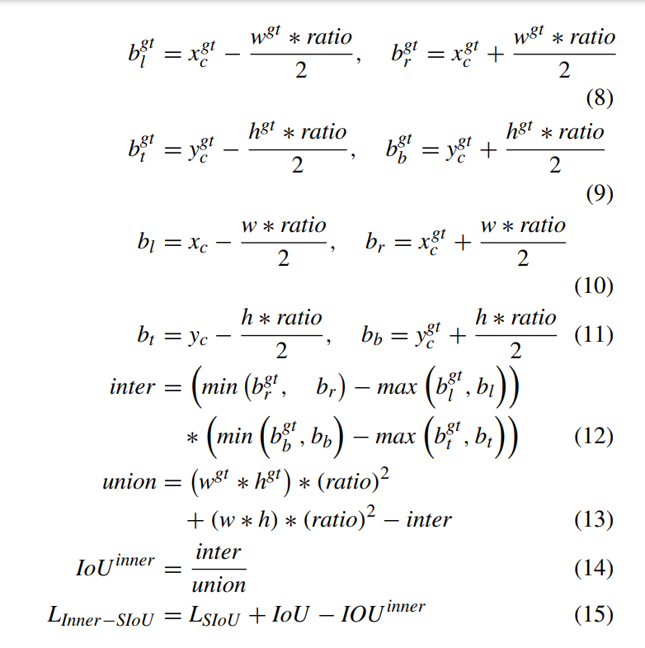
PROPOSED METHOD
INNER-SIOU LOSS FUNCTION
Problem:
Standard IoU (Intersection over Union) doesn't always give enough feedback when the box is a little off.
It doesn’t adapt well to different object sizes, especially when targets are tiny or unclear.
Solution:
It uses auxiliary (helper) bounding boxes — boxes inside the real one — to give better feedback during learning.
If the model’s prediction is close to the helper box, it gets a smaller penalty, and it learns faster.
It also adjusts the “punishment” based on object size — small objects are handled more carefully.

Slide 15
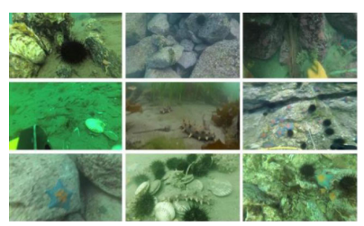
RESULTS AND METRICS
DATASET - URPC2021
6575 images of marine life (echinus, holothurian, scallop, starfish, water weeds)
The dataset is randomly divided into training, validation, and test sets in a ratio of 7:2:1

Slide 16
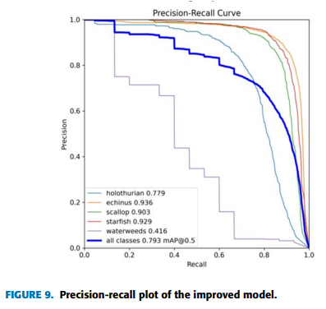
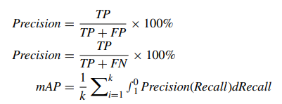
RESULTS AND METRICS
METRICS USED
Precision, Recall, mAP@0.5, mAP@0.5:0.95, FLOPs, Parameters

Slide 17
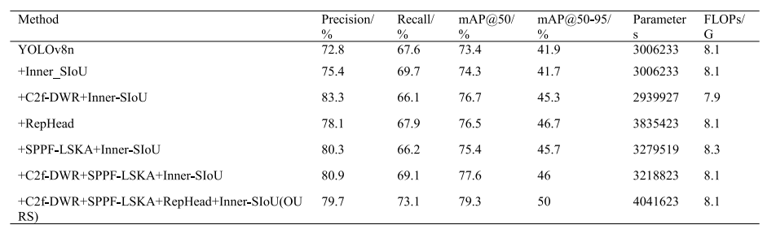
RESULTS AND METRICS
PERFORMANCE COMPARISON

Slide 18
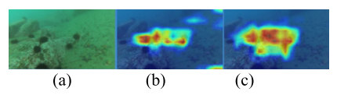
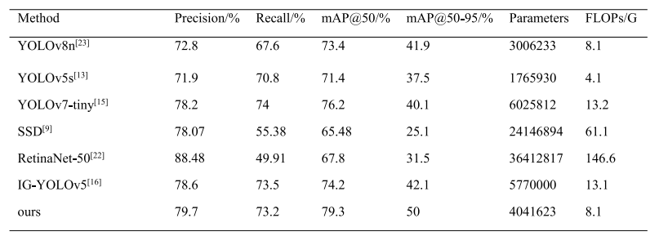
RESULTS AND METRICS
PERFORMANCE COMPARISON

Slide 19
CONCLUSION
YOLOv8-UC is more suitable for underwater object detection than baseline YOLOv8n, showing both accuracy and computational efficiency improvements.
TASK DIVISION
A Jyothiraditya - Model Architecture Setup
M Akash - Data Preprocessing & Dataset Handling
M Dhanush - Training & Loss Function Integration
Ch Sai Madhav - Evaluation, Visualization & Comparison

Slide 20
THANK YOU
Team 11

